Slide 1
Biographical experiences of Polish healthcare workers in the context of the marketization process
Jacek Burski, Faculty of Social Sciences, University of Wrocław

Slide 2
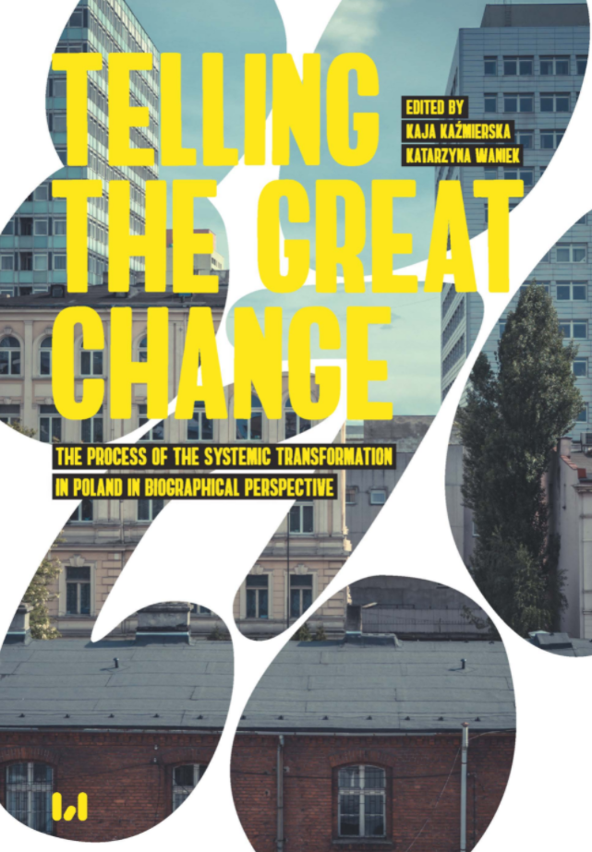
Introduction
Project NCN OPUS 13 “Experience of the process of Transformation in Poland. Sociological Comparative Analysis Based on Biographical Perspective,” financed by the NCN program OPUS V UMO2013/09 / B / HS6 / 03100), which was implemented in 2014-2017 by the Department of Sociology of Culture at the University of Lodz.
Focus on biographical approach implemeted in exploring process of transformation in Poland
Autobiographical narrative interview method (developed by Fritz Schütze)
96 interviews collected with different categories of Poles including healthcare workers

Slide 3
Introduction
Project NCN OPUS 19 „COV-WORK: Socio-economic consciousness, work experiences and coping strategies of Poles in the context of the post-pandemic crisis”, funded by the National Science Centre in Poland, the NCN project number UMO-2020/37/B/HS6/00479
Socio-economic consequences of COVID-19 pandemic on the world of work in Poland
Research focus on three sectors:
Healthcare and social care (3 cases already conducted)
Education
Logistics

Slide 4
Process of Marketization (1)
Political and economical background:
The shift after 1989 but the market logic was present before the systemic change (never absent to be fair)
Privatization process which was one of crucial mechanisms of establishing the market logic in the centre of new Polish economy
However, marketization process is broader phenomenon related to the introduction of the market logic into various spheres (i.e. public sectors: healthcare, education, social insurance, etc.) and it’s not limited to political or economic aspects

Slide 5
Process of Marketization (2)
Marketization of Polish healthcare system:
Law changes started in the 90’ which slowly introduced more and more market into the system;
Public debates on economic results as criterium of effective or non-effective healthcare management;
Patients transfer from public sphere to private: from 2015 to 2018, the number of people paying extra for private health insurance increased from 1.4 million to 2.6 million
Main question: how this process affected healthcare workers?
The thesis: ambivalences of the process, however it should have increased trajectory potentials (Waniek 2019) (trajectory is one of processual strutures pointed by Schütze as dominant rules of one’s biography)

Slide 6
Empirical cases
Before the pandemic Interviews conducted in 2014-2017; already analysed | During the pandemic (COVWORK Project) Interviews conducted in last 2 months, preliminary findings
Ada (1965) – medical technician, experience of the pretransformation, transformation and „posttransformation” institutional change | Kuba (1975) – head of hospital ward, well etsablished position, however „trapped” in extensive work (work and life balance at stake)
Adam (1972) – nurse, moved from classic permanent work contract to B2B one | Karol (1994) – entering the healthcare world, experiencing harshly the pandemic waves (especially 3rd one)
Dobrochna (1988) – young doctor entering the healthcare world (between Weber’s calling and profession) | Paulina (1991) – still at the beginning of her career
Hanna (1981) – extensive work as main trajectory potential

Slide 7
Preliminary Research Findings
PREPANDEMIC: Ambivalences of the marketization process
Adam: Higher income vs weaker position in the workplace and unsecured future
Hanna: Normalization of extensive work and combining working in private and public sector
Ada: Weakening of her position in the hospital to the point when her role was outsorced
PANDEMIC: Institutional crisis vs strenghtening of public sector
Karol: entering a public service system weakened by market logic leads to intensification of trajectory potentials work
COVID-19 as important factor in further analysis
Potential change: growing importance of public healthcare sector
Next steps:
New BNI with the medical staff from Polish healthcare system
Broadening the perspective by implementing material from FGIs, expert interviews and quantitative research

